Slide 1
HTML & CSS 101
Second Lecture
By Yordan G. Yordanov 2024

Slide 2

All materials can be found in my github:
github.com/YorDN

Slide 3
What we learned so far:
<p></p> - paragraph element (used for text)
<h1..6></h1..6> - h1 to h6 element (used for titles)
<a></a> - anchor element (used for links)
<img></img> - image element (used for images)
<button></button> - button element

Slide 4
What we learned so far:
EVERYTHING IS A CONTAINER!
<div></div> - block element container used to store data
<span></span> - inline element container used to store data just like the div

Slide 5
What we learned so far:
Inline vs Block element
Inline items take as much space in a row as they need
Lorem (this is a inline element)
Block elements take up the whole row
Lorem—----------------------------------------------
(this is a block element)

Slide 6
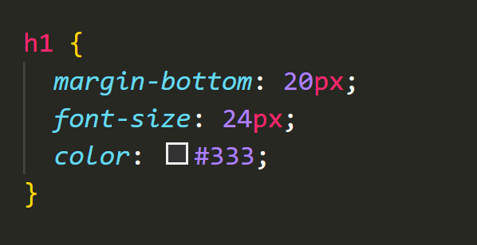
What we learned so far:
CSS structure:
h1 - the element we want to access
margin,font.. - properties

Slide 7
Today we will discuss:
The structure in a website and how to implement it
Position relative/absolute
header/footer/main
Buttons
Padding
Hover, Active states
Pseudo classes
Flexbox in detail
Misc features

Slide 8
The structure of the good websites

Slide 9
The structure of the good websites
Every website should have a header:
The header should always be stationary - it should never move out of the screen. How do we do that?
With the position property!

Slide 10
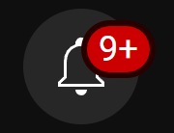
The structure of the good websites
position fixed - the element is fixed and no matter what stays in place
position absolute - same as position fixed, but the element is not fixed. Used in combination with position relative.
position relative - the element is always on top. Combined with position absolute can be used as for example a notification icon:
The bell is position absolute
The 9+ is position relative

Slide 11
The structure of the good websites
With any position property we have to specify how many pixels(or any other system) away from the top,bottom,left or right the element should be.
The following element has top:20px, left: 100px, right: 0px:

Slide 12
The structure of the good websites
In HTML we have
<header></header>, //for header
<main></main>, //for the main content
<footer></footer> //for the footer
attributes. Note that they are no different than any other div element and are meant for readability purposes so it’s a good practise to have them.

Slide 13
Buttons

Slide 14



Buttons
We are going to create a button based on our knowledge from the past lecture and expand it even further!
The button will look like this:
default
when hovered
when clicked

Slide 15
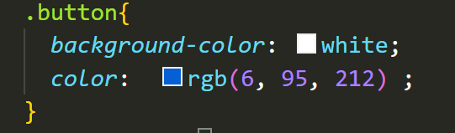
Buttons
First we create the button as we know and give it a class:
And that’s it for the HTML part now CSS!
First we change the background color and the color of the text:

Slide 16

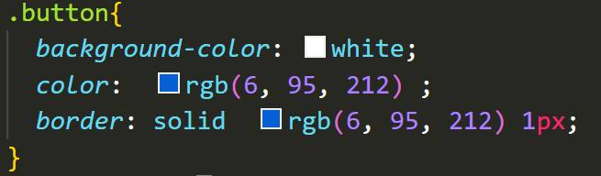
Buttons
But our button looks like this:
We want to change the border’s width, color and style. We do that with the border property:
solid stands for the style of the border (notice how our border is two-colored),
the second item is the color of the border and the third is the thickness of the border

Slide 17

Buttons
Our button looks now like that:
But the final design is:
We want more space in the button. We do that with padding.
Think of padding like margin, but on the inside - how much space the button has between the border and the text.

Slide 18
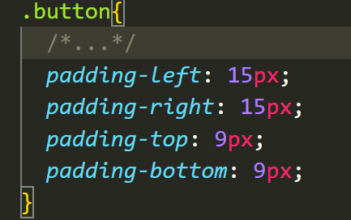

Buttons
We add the padding and this is the result:

Slide 19
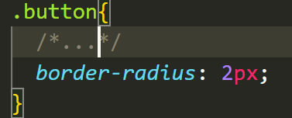
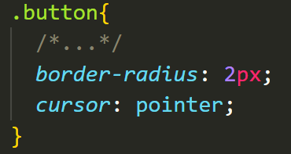
Buttons
Now we only have to round the corners. That happens with the border-radius property:
If we want the cursor to be pointer when the button is hovered we use the cursor property
the pixels is how much the corners should be rounded

Slide 20
Buttons - pseudo classes
The last thing we need to do is to change the colors of the button when hovered and when activated. This can be easily made with pseudo classes.
Pseudo classes tell the computer to do something when the specific state is achieved. We will discuss 2 pseudo classes today: :hover & :active

Slide 21
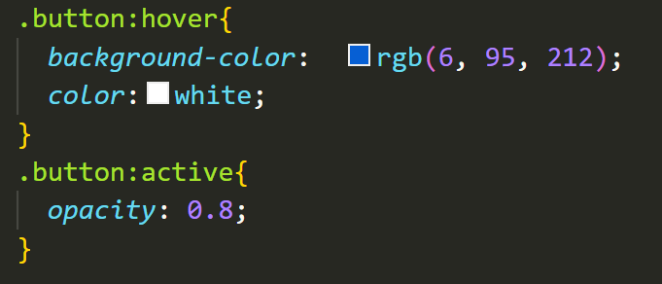
Buttons - pseudo classes
:hover - does something when the mouse hovers the item
:active - does something when the mouse clicks the item
With that in mind we
can add the classes:

Slide 22
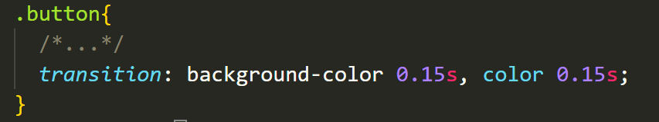
Buttons - pseudo classes
Finally to smoothen the animation we can use the transition property in the .button class. We tell what property we want to transition and for how many seconds.If we have more than just a one property to transition we separate them by coma:
And just like that the button is finished!!!

Slide 23
Flexbox in
more detail

Slide 24
What is flexbox used for?
Last time we looked at flexbox in a very simple matter. Now we are going to explain what it is used for!
Flexbox is used mainly for 2 reasons:
1)To center an element/s
2)To flex an element based on the screen’s size

Slide 25
How to center an element using flexbox
To center an element vertically we use:
align-items: center;
To center an element horizontally we use:
justify-content: center;
Now these properties can have many other values other than center, but for now that’s enough.

Slide 26
How to flex an item using flexbox
To flex an item using flexbox we use the flex property given to us by the flexbox.
To flex an item we can use flex:1;
Flexing an element is useful when we want to optimise our website for mobile devices. For example we want our search bar to stretch based on the user’s screen.

Slide 27
Useful
features of css

Slide 28
Useful features of css - The strong element
One useful feature in css is the <strong></strong> element.
It gives you the ability to style a single word or a single part of the text. Meaning that a single word can be managed apart from the rest of the text.
The strong element in particular gives the text that is inside the element a font-weight of bold (the text is bold), but we can do anything really to it.

Slide 29
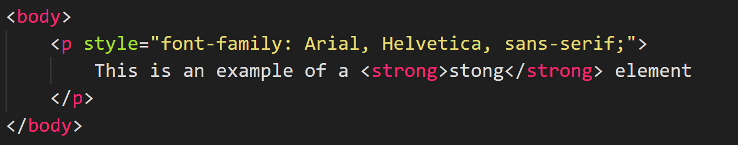
Useful features of css - The strong element
Let’s assume we have a paragraph element and some text in it. We add a strong element in it like this:
And we get that:

Slide 30
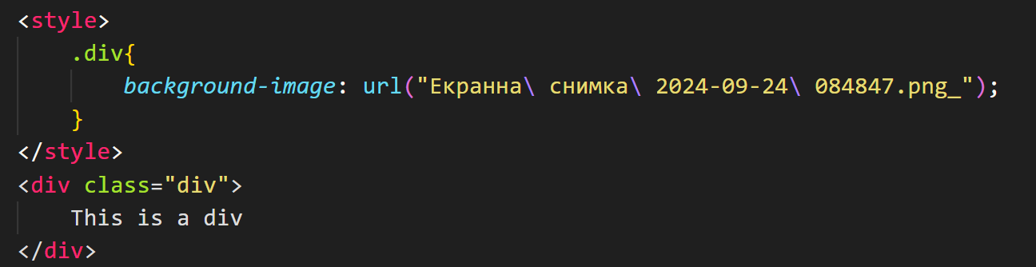
Useful features of css - The Background-image property
The background-image property of CSS gives us the ability to as the name implies to make the background of an element to an image:

Slide 31
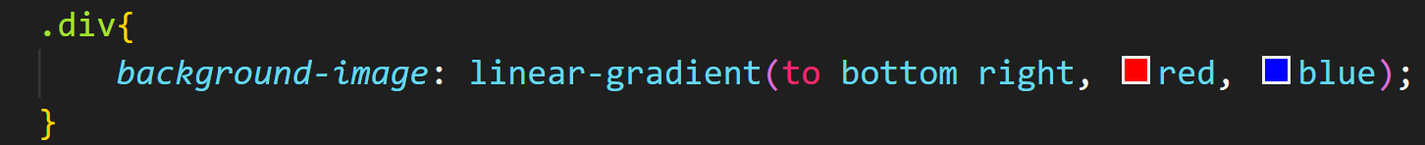
Useful features of css - The Background-image property
Or we can use it to add gradient to the background(set the background color to a gradient). Today we will see only linear gradient as it is the most popular.
First we specify the direction of the gradient, then we list the colors - we can have unlimited colors

Slide 32
Useful features of css - The Background-image property
We get the following result:

Slide 33
Useful features of css - The Before and after property
In CSS we can add an element before or after an element. This element is entirely created in CSS.
The ::before property is a pseudo class and it creates a virtual div before the element. The div acts like it has position relative - we have to specify how many pixels it is from the top, bottom, left and right of the element.
The ::after element is like the ::before element, but it puts the element after.

Slide 34
homework
time🥳

Slide 35


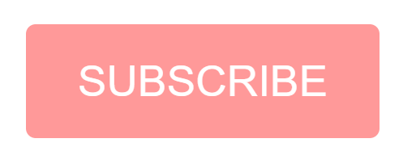
Homework:
Create the following button based on the knowledge you acquired today. Use flexbox to center the button both horizontally and vertically. The button does not have a border so use border:none;. For the color use red. Make the cursor pointer and all transitions should be 0.15s!
default
hovered
active

Slide 36
Thank you for listening!
Yordan G. Yordanov

